Slide 1




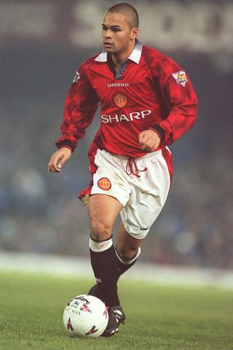




AUTISM & NEURODIVERSITY WORKPLACE MASTERCLASS
Sports Edition
Day 1

Slide 2
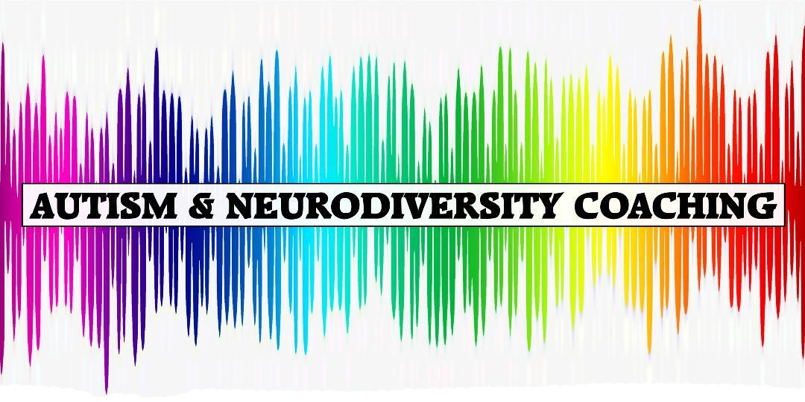

We may also show this presentation on our YouTube Channel, to make it accessible for those not on Facebook!

Slide 3
Who are Autism & Neurodiversity Coaching?
Our team contains neurodiverse employees & was founded by Ben Holmes
Ben is a Qualified Autism Practitioner & is Autistic himself
He also has ADHD, Dyspraxia, OCD, Anxiety & Depression

Slide 4
Who are Autism & Neurodiversity Coaching?
We provide coaching and training sessions that are completely tailored to the individual or organisation.
Available Services
Training for businesses of all sizes
Mentoring for staff & management
Coaching for neurodiverse individuals
Awareness sessions/coaching for families of a neurodiverse individual
And lots of other neurodiversity related ‘stuff’!
We mainly operate online so that we can support as many businesses & individuals as possible but also do in person events.

Slide 5

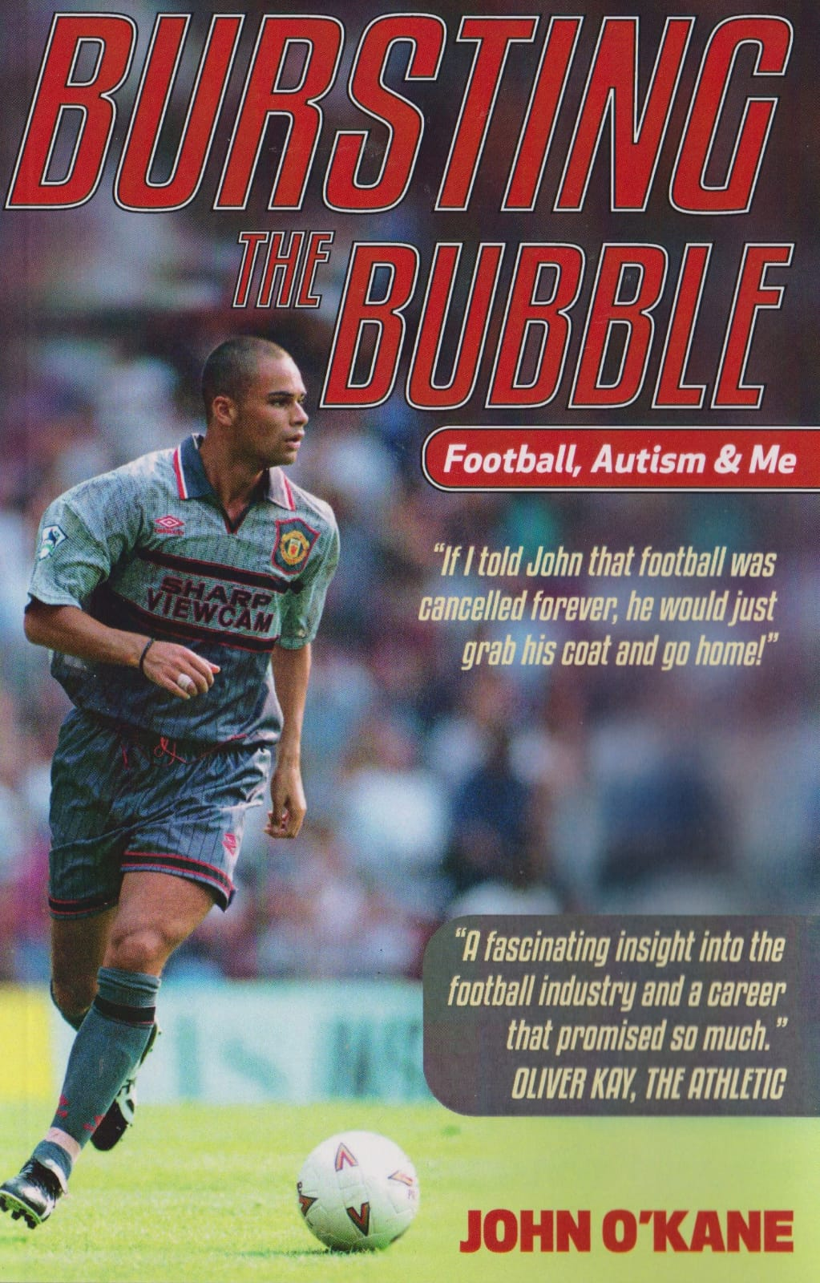
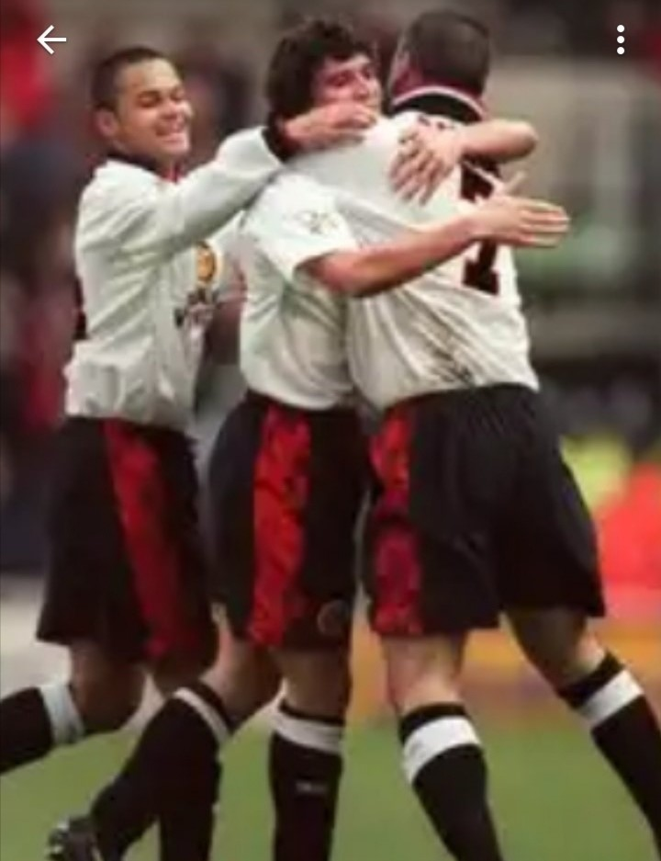
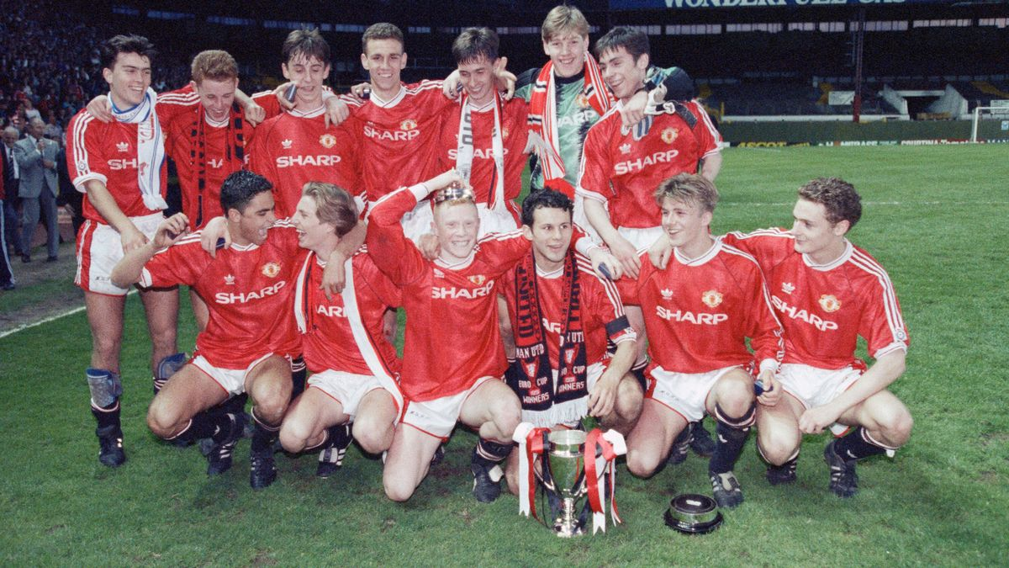
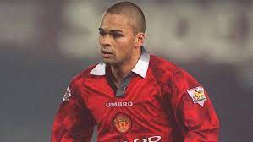
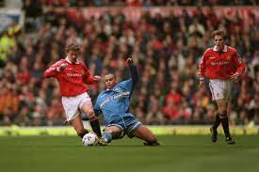
Who is John O’Kane?
Ex professional footballer who played for Manchester United!
Played under SAF & roomed with David Beckham!
Part of the Class of 92 team!
Also played with Eric Cantona, Roy Keane, Peter Schmeichel, Ryan Giggs, Paul Scholes, Gary Neville, Denis Irwin & Andrei Kanchelskis
Autistic!

Slide 6

Why are you here?
To learn about Autism, Neurodiversity & Mental Health & how it affects people with the conditions.
By learning more about the above, this will help your business to:
Support your neurodiverse employees & those with mental health issues. Which will...
Improve employee wellbeing. Which will...
Increase their productivity. Which will...
Boost your income!!!

Slide 7
&
Support your neurodiverse customers & customers with mental health issues. Which...
Makes customers want to speak to you more! Which also...
Makes them buy from you more! Which of course...
Boost your income!!!

Slide 8
How it works & what we’ll be covering
Monday What is Autism, What is Neurodiversity, Strengths & Struggles of autistic employees within Sport
Tuesday The recruitment process and hiring autistic staff in the sports industry
Wednesday What is ADHD, Dyspraxia, Dyslexia & the Strengths & Struggles of these other neurodiverse employees, & the recruitment process of hiring & retaining them
Thursday What is Mental Health & how this affects your employees/customers, recap of the last 4 days
Each day John will include some personal experiences that he had playing for one of the biggest football clubs in the world – Manchester United!
Friday Meet the rest of the team for Interviews with previous clients/colleagues & explaining what else we have coming up
Saturday Meet the rest of the team for Interviews with previous clients/colleagues & explaining what else we have coming up
Sunday Meet the rest of the team for Interviews with previous clients/colleagues & explaining what else we have coming up

Slide 9

Useful Business information
How much does it cost to hire a new employee?
In the UK this can cost on average £3,000 to recruit, training over £1,000 & numerous other costs
How much does it cost to replace an employee?
In the UK the average cost of employee turnover based on the average salary is around £11,000 per person.
Other sources say that it costs over £30,000 to replace a staff member!
Others say that replacing an employee can range from 1 half to 2 times the employee’s annual salary
Some figures are even higher!
So surely it’s worth retaining good employees’ right? And this includes autistic employees yea?
So this means supporting them too, especially when...

Slide 10

Useful Business information
Only around 22% of autistic people are in paid work!
And between 14-16% of autistic people in full time work!
Yet much more than that CAN work and WANT to work!
Many recruiters refuse to employ autistic people (even if they don’t realise they are doing it!) and most don’t provide the right environment for them to apply for jobs or interview, yet alone actually thrive in their jobs!

Slide 11
What is Autism?
Let’s start with what autism is not!
A disability in itself (being around people that don’t support you disables you & you can also have disabilities that go with autism)
A disease that needs to be cured
A Mental Health condition
A learning difficulty/disability
A disorder
A mental retardation or a lack of intelligence

Slide 12



Different names for Autism
Autism Spectrum Condition (ASC) - (Condition isn’t great)
Autism Spectrum Disorder (ASD) - (Disorder)
Asperger Syndrome - (Hans Asperger)
High & Low Functioning Autism - (Belittles HF & limits LF)
Autism
OK
Personal Preference: However...each autistic person has the right to refer to themselves in whichever way they want. So if you’re autistic choose whichever you want!

Slide 13
Autism History & Prevalence
The word "autism" comes from the Greek word "autos," which means "self“
It has been around for as long as other humans have
But it’s new in terms of people understanding it!
Autistic people are born autistic and will die autistic!!!
Prevalence rates are different in different countries:
Over 1% in the UK
Over 2% in USA

Slide 14


Autism Myths
We’re not all autistic!!!!
You can’t just have a little bit of autism! You can have similar traits but you are or you aren’t.
All autistic people do not have a special talent (although many do)
Autism is not caused by vaccines!
Autism is not a childhood condition
Autism cannot and should not be cured!

Slide 15
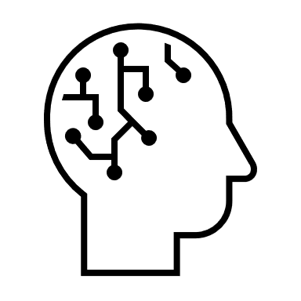
Characteristics of Autism
(Not every autistic person has every one)
Restrictive & repetitive behaviours & movements
Lack in social skills & social interaction
Limited interests & diet, & generally be inflexible (thinking/timings etc)
Dislike change or disruption to routines
Difficulties with eye contact/display unusual eye contact
Extremely passionate about specific topics or objects

Slide 16
Characteristics of Autism
(Not every autistic person has every one)
Appear different/weird/unusual/have unusual interests
Honest & use logic!
Rituals & patterns of behaviour
Have sensory difficulties (lights, sounds, smells)
Executive functioning difficulties (getting distracted, blocking out other events)
Well above average with some things but well below average with other things (Spiky profile)

Slide 17

Autistic Strengths within Sport
Attention to detail – spotting patterns of play/scouting opponents
Preferring routines – consistency & organisation
Exceptional memory for facts/numbers/events – data analysts
Being different – possessing different skills (it’s believed Lionel Messi is autistic!)
Honesty – more clear in communication
Creativity – new coaching ideas/utilising new skills/finding different ways to win
Intense focus on a favourite activity – high concentration & less likely to become lazy or switch off

Slide 18

Autistic Strengths within Sport
Punctuality & reliability – arriving at training on time/being there for others who need them
Big picture thinkers – may visualise a team/player achieving more than they believe they can
Loyalty – may stay with a team/coach/player for a long period of time
A fondness for rules – team player/not getting red carded/not breaking team policies
Not influenced by the majority – may pick the best team rather than the popular team
Less emotional at times – may be able to think clearer during an important game/match

Slide 19
Autistic Struggles within Sport
Socialising – team bonding or events/being popular amongst teammates
Honesty – not diving for a free kick/claiming a corner which wasn’t theirs
Navigating illogical rules/policies – getting yellow carded for a foul they didn’t commit
Plans changing – team systems changing/moving clubs/fixtures or training rearranged
Talking skills – may talk less/not understand what they’re meant to say
Banter – may not understand this, may take things literally

Slide 20
Autistic Struggles within Sport
Climbing the ladder – may not possess social skills to do this (applying for a manger role)
Anxiety – performing in front of large crowds/teammates
Opposition fans/spectators – may react to abuse or be unable to block out
Challenging authority if they don’t agree with them – disagree with managers or coaches
May only be able to play/perform a certain way – using 1 foot/holding a racket ‘wrongly’
Coordination – running differently/timing when jumping

Slide 21
What is Neurodiversity?
The term Neurodiversity describes variations in the human brain, and how the brain is wired differently.
This includes how people interact socially, how they learn, their attention skills, mood regulation, and other mental functions.
There is much debate as to which exact conditions make up neurodiversity. For example OCD is an Anxiety Disorder and therefore not a neurodiverse condition, but others would disagree. However, it is commonly accepted that it includes Autism, ADHD, Dyslexia, Dyspraxia, Dyscalculia, and Dysgraphia. These conditions are lifelong, do not go away and people do not grow out of them.

Slide 22
What is Neurodiversity?
People often confuse neurodiversity with a mental health condition.
A key difference is that mental health conditions fluctuate over time. The term neurodiversity was created in 1998 by Australian sociologist Judy Singer.
There is also much debate as to whether neurodiversity is a disability or not. Many autistic people and those with ADHD do not refer to them having a disability, but may class their Dyslexia or Dyspraxia as one.

