Slide 1




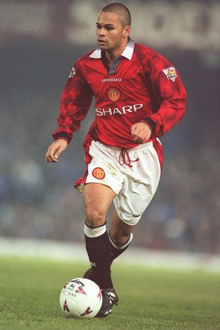




AUTISM & NEURODIVERSITY WORKPLACE MASTERCLASS
Sports Edition
Day 3

Slide 2


We may also show this presentation on our YouTube Channel, to make it accessible for those not on Facebook!

Slide 3

Key Points from Day 2!
Autistic people aren’t applying for jobs, even if they want the job!
Your company is missing out on great employees because of job applications, interview processes, lack of social skills understanding, illogical company policies & an environment that doesn’t fit their unique skills!
A few small changes can make a big difference! To the employees & your business!

Slide 4

What is ADHD?
Attention Deficit Hyperactivity Disorder is a condition that includes symptoms such as inattentiveness, hyperactivity and impulsiveness.
They are categorised into 2 types –
1. Inattentiveness (ADD) 2. Hyperactivity & Impulsiveness
BUT some have a mixture of the 2 types!
Is it a Disorder? Well it can bring extreme difficulties BUT it can bring extreme advantages....so depends how you look at it!!!

Slide 5


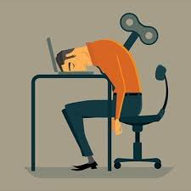

Characteristics of ADHD
• Short attention span & difficulty listening
• Constantly fidgeting and being restless
• Sometimes acting without thinking
• Unorganised & struggle to stay on task
• Easily bored & distracted
• Talks quickly, likes to be on the go

Slide 6



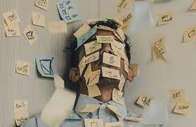
Characteristics of ADHD
• May make careless mistakes
• Money struggles (planning, impulse buying)
• Difficulty following through with tasks
• Forgetfulness & struggles with daily tasks
• Short term memory issues
• Wanting to do everything at once & being overwhelmed

Slide 7

ADHD strengths within sport
Motivation, Drive & Determination – can inspire others/set high targets/will to win
Risk taking – all successful athletes/players/coaches need to take risks
Passion & Hyperfocus – you have to love what you do, hard work = success
Living in the moment
Entrepreneurism
Creativity & outside the box thinkers

Slide 8

ADHD struggles within sport
Recklessness – getting sent off/putting it all on the line
Getting bored – repetitive actions may be hard for them
Frustration – getting angry at themselves/falling out with others
Impatient – may want to attack if playing defensive
Sometimes seen as arrogant – may be confident in their abilities
Rash decisions & anger issues – may try the improbable/overstep the line
*Cristiano Ronaldo has many of the characteristics of ADHD*

Slide 9

What is Dyspraxia?
The main features of Dyspraxia are related to motor skills (movement)
They are fine motor skills & gross motor skills
You can also have a mixture of both
People who have Dyspraxia often find the routine tasks of daily life such as driving, household chores, cooking and grooming difficult. They can also find coping at work is hard. People with Dyspraxia usually have a combination of problems.

Slide 10

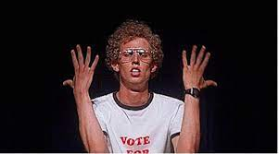

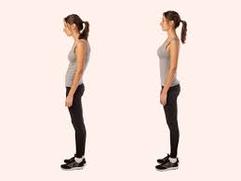
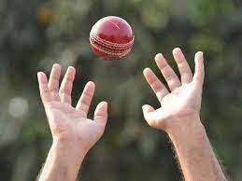


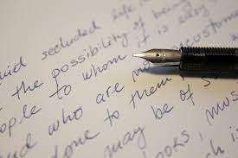

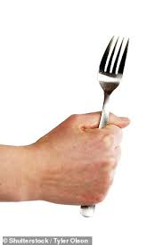
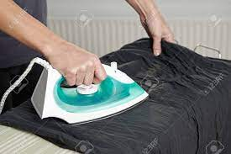
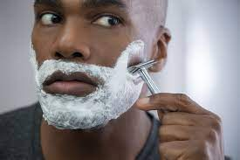
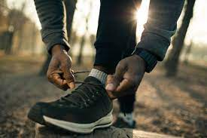
Gross Motor Skills & Fine Motor Skills
Gross Motor Skills: Struggles with balance, posture, integration of the two sides of the body, hand-eye co-ordination, rhythm, clumsy, movement, changing direction, stopping & starting actions
Fine Motor Skills: Struggles with manual dexterity, two-handed tasks, manipulative skills, inadequate grasp, grooming activities

Slide 11
Characteristics of Dyspraxia?
May struggle with speech (talk continuously/organising talking sequences/unable to pronounce some words) & eye movements (following a moving object smoothly/losing their place whilst reading/poor relocating)
Perception relating to different senses – poor visual perception, over-sensitive to light and/or background noises, over/under sensitive to touch, smells & tastes, spatial awareness issues, little sense of time, speed, distance or weight, inadequate sense of direction

Slide 12
Characteristics of Dyspraxia?
Thought & Memory – difficulty with planning & organising thoughts, poor short term memory, issues with maths/reading, accuracy problems (copying movements), concentration issues, may struggle to do moiré than one thing at a time, slow to finish a task
Emotion & behaviour – difficulty listening in large groups, slow to adapt, impulsive, erratic

Slide 13
Dyspraxia Strengths within Sport
Leadership – can make great managers/coaches
Empathy – can understand and develop others around them, passing on their knowledge
Strategy – coming up with new training plans/tactics
Problem solving – finding a way to win/being able to implement new systems
Determination & resilience – driven to get results/can overcome setbacks
Enthusiasm & passion – cares about their work/wants to help others
Creativity – can produce moments of brilliance/new techniques/do things differently
Noticing small details – spotting talent/behaviours/weaknesses or strengths in others

Slide 14
Dyspraxia Struggles within Sport
Technique – may have to do things their own way when holding equipment/movement/skill
Fatigue – certain activities may tire them
Multitasking – may struggle to do multiple activities at once
Movement – jumping/running/turning actions/body shape
Using their hands – setting up equipment like netting/barriers/manipulating things/shoelaces

Slide 15
What is Dyslexia?
Dyslexia is a common learning difficulty that can cause problems with reading, writing and spelling. It's a specific learning difficulty, which means it causes problems with certain abilities used for learning, such as reading and writing.
Unlike a learning disability, intelligence isn't affected.

Slide 16
Characteristics of Dyslexia
Reading – re-reading, moving/overlapping text, losing their place, words being jumbled
Spelling – similar sounds casing confusion, hearing sounds, remembering words
Listening – background noises, problems note taking
Writing – problems with finding the right word, organisation, getting ideas on paper
Memory – sequences, dates, alphabet, phone numbers
Motor skills – co-ordination, handwriting, difficulty copying
Speed (slower to talk, read or write), behaviour issues, planning, & direction issues

Slide 17
Dyslexia Strengths within Sport
Think outside the box – game changing ideas
Practical – create solutions & innovative systems
Visual thinkers – big picture ideas
Pattern detection – spotting different styles/methods
Goal orientated – may get things done at speed
Creativity – different styles of play, visionaries

Slide 18
Dyslexia Struggles within Sport
Reading/writing lesson plans
Blocking out external noises or people
Communicating at press conferences/training/games
May take longer to understand tactics/plans/methods
May be seen as not intelligent by peers

Slide 19

The recruitment process of hiring & retaining them
We went through a lot of factors for autistic people & many of these apply to other neurodiverse employees, but a few for each condition are listed below:
ADHD – applications may bore them too much! They may talk too much at interviews! They may need to do different tasks, may be unable to sit still, and may struggle to concentrate/focus. Keep questions to the point.
Dyspraxia – may struggle using your equipment, may get lost on the way to the interview, be unable to set up props such as whiteboards for presentations, and struggle with directions.
Dyslexia – may struggle with reading applications/interview questions, may need more time to process info, and may struggle with public speaking where they have to read off of something.

