Slide 1




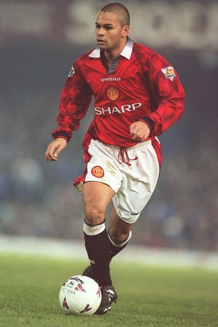




AUTISM & NEURODIVERSITY WORKPLACE MASTERCLASS
Sports Edition
Day 4

Slide 2


We may also show this presentation on our YouTube Channel, to make it accessible for those not on Facebook!

Slide 3
Key Points from Day 3
What is ADHD – inattentiveness & hyperactivity & impulsiveness
ADHD Strengths – motivation, passion, risk takers, Hyperfocus
What is Dyspraxia – gross & fine motor skills
Dyspraxia Strengths – leadership, creativity, empathy, determination
What is Dyslexia – reading, writing, spelling, memory, listening
Dyslexia Strengths – outside box & visual thinkers, patterns, practical

Slide 4

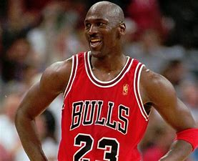
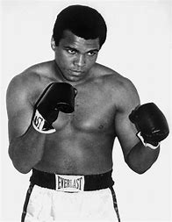
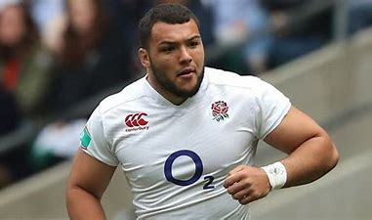
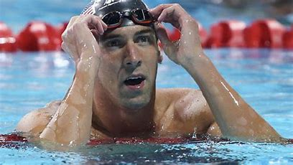
Famous sports people with neurodiverse conditions
Lionel Messi – Autism
Michael Jordan – ADHD
Muhammad Ali – Dyslexia
Ellis Genge – Dyspraxia
Michael Phelps – ADHD

Slide 5

What are Mental Health Disorders
OCD
Generalised Anxiety Disorder
Social Anxiety Disorder
Depression
Bipolar
Borderline Personality Disorder
PTSD
Schizophrenia
& many more!

Slide 6

What are Mental Health Disorders
Everyone has Mental Health, but not everyone has Mental Health Disorders/Illnesses.
There are many types of these disorders and there is such a wide range of them. They affect your mood, thinking and behaviour.
Some are very severe and can impact daily life for someone with the disorder, and others can be managed much easier.
All come with their own challenges but also their own strengths.
We’re going to look at a few now...

Slide 7



Anxiety Disorders
Some people only know an Anxiety Disorder as one thing and don’t realise there are many types of Anxiety Disorders including PTSD and Panic Disorder but we are going to focus on the ones that we have the most expertise in.

Slide 8
Generalised Anxiety Disorder (GAD)
I often refer to this as random anxiety also, as sometimes I don’t know whether I’m going to have it or not. To make matters worse, I could do the same thing twice and get anxiety one time but not the other.
Concentration
Sleeping problems
Ongoing or excessive worry
Irritable & restless
Loss of appetite
Sweating
Fatigue
Stomach cramps
Impending doom
Increased heart rate
Wanting reassurance
Hyperventilating
Over thinking
Light headedness
Muscle tension

Slide 9









Social Anxiety Disorder
Some of the symptoms here are similar to GAD. Social Anxiety can create an overwhelming fear of social situations, which could lead to sufferers avoiding going to social events or communicating with their friends or loved ones.
Some of the symptoms are:
Over awareness of self

Slide 10
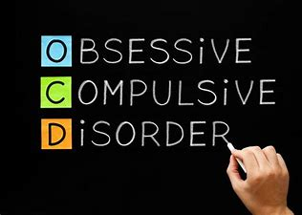
Obsessive Compulsive Disorder (OCD)
OCD is often misunderstood. It is a type of Anxiety Disorder and is much more severe than people think. It’s not just about cleaning & everyone does not have a little bit of OCD.
It can be debilitating and is one of the worst disorders to have. It does however bring its own strengths though! Now let’s look at what forms OCD!

Slide 11
Obsessive Compulsive Disorder (OCD) Symptoms
I often refer to this as random anxiety also, as sometimes I don’t know whether I’m going to have it or not. To make matters worse, I could do the same thing twice and get anxiety one time but not the other.
Constantly checking things over and over – car door locking
Symmetry obsessions
Hoarding
Obsessions mentally (repetitive worries or thoughts)
Isolation
Contamination obsessions
Constant worry or fears
Distressing images in head
Constantly replaying past memories over and over

Slide 12

Obsessive Compulsive Disorder (OCD) Symptoms
The main example that I use when explaining OCD is the INTRUSIVE THOUGHTS!
Many people like being clean & tidy but it doesn’t mean they all have OCD.
Intrusive thought are an integral part of life for most people with OCD!
Let’s look at some of the very worrying intrusive thoughts that someone with OCD may have.
Please also remember that most people with OCD don’t ever act upon these thoughts, but have to fight really hard to not do anything with the thoughts!!

Slide 13
Obsessive Compulsive Disorder (OCD) Symptoms – Intrusive thoughts
Wanting to jump off a cliff or high rise building
Throwing babies or pets
Punching a loved one for no reason
Swearing randomly when its really quiet/ shouting at someone
Jumping in front of train track or car
Driving their car off the road
Running through a window
Constantly thinking about their family dying
Thinking about touching a friend inappropriately even though they don’t find them attractive
Wanting to laugh when someone has died or had bad news

Slide 14

Depression
Depression can last for weeks or months and anyone can get it anytime.
Many things can cause depression such as key life events (losing a loved one, losing a job, getting divorced), family history, or giving birth.
Now let’s look at some of the symptoms of it!

Slide 15
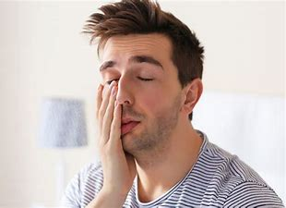

Depression Symptoms
Fatigue
Sadness
Sleep problems
Thoughts of suicide
Irritability
Loneliness
Frustration
Stop looking after themselves
Loss of interest in normal activities
Not showering/ shaving etc

Slide 16

All of the above conditions can affect your employees and customers so please try to remember this if they display the signs or tell you that they have the condition!
Thanks for attending & don’t forget we have sessions for the next 3 days!

